Slide 1

Solar Power Plant Design

Slide 2
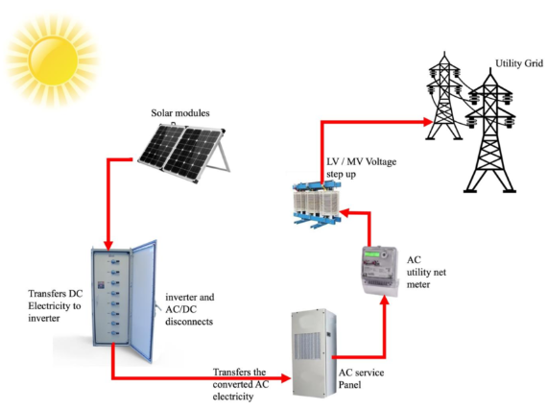
Solar Power Plant Design

Slide 3
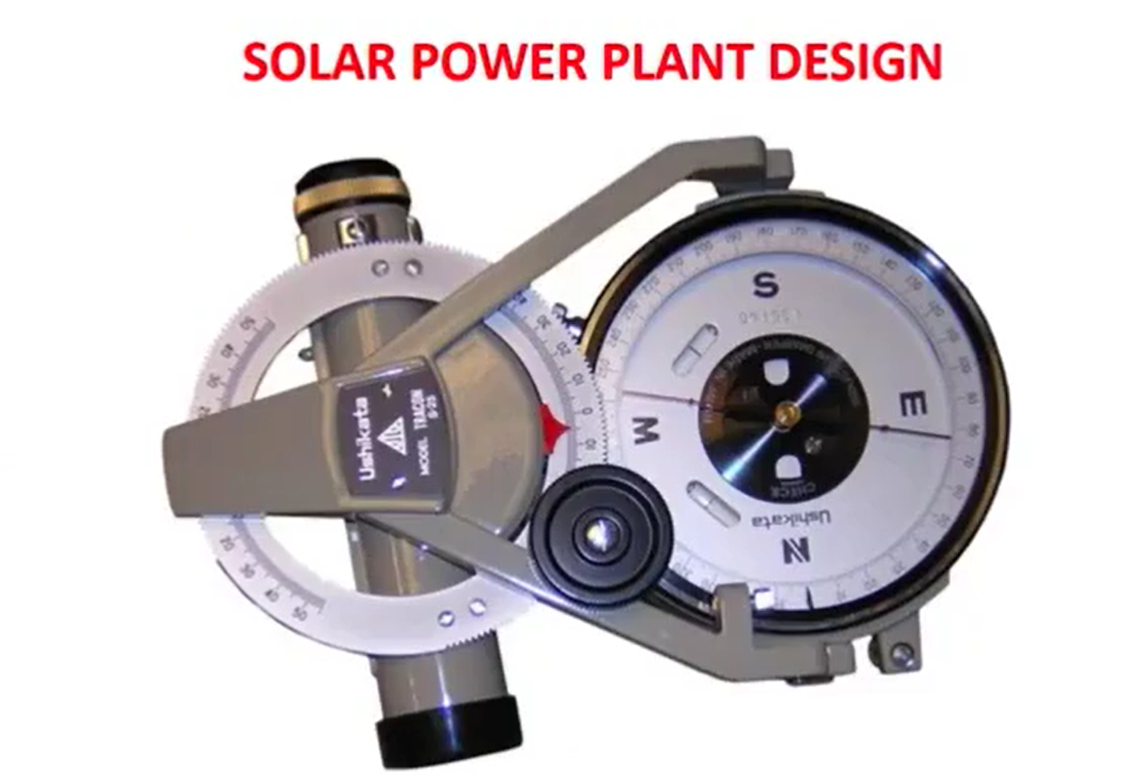

Slide 4
Name of the site: |  |  | Date
Site address:
SI.No | Point description | Observations | Remarks
1 | Site Co-ordinates (Latitude & Longitude)
2 | Total Area available
3 | Situation of the Land
4 | Ground Water depth (to be verified from the locals) and of available water
5 | Any River/Pond/Natural drain running through the land
6 | If any River/Pond/Natural drain is running then possibility of diverting is there? (Give brief description)
7 | Type of soil

Slide 5
SI.No | Point description | Observations | Remarks
8 | Nature of soil
9 | Type of Approach road and approx. length
10 | Width of a roach road.
11 | Tentative undulation (highest& lowest point approx.)
12 | Water logging occurs after rain or not?
13 | Surrounding boundary of the site

Slide 6
2. Shadow related issues
SI.No | Point description | Observations | Remarks
1 | Any Big Tree/high voltage grid line going through the site? (Describe location, height of obstruction etc.
2 | Any hill is there inside the land area? If yes then give description like approx. height and location i.e. in North/South/East/West
3 | Any hill/other-obstruction is there outside the plant boundary situated other than North side & capable of posing shadow in the land under discussion? Please give the Approx height and distance of such obstructions (hill/tower/tree etc) from the plant boundary

Slide 7
3. Power Evacuation related issues
SI.No | Point description | Observations | Remarks
1 | Name and address of the Utility Company? Who is the contact person of the concerned Utility Company regarding inter-connectivity?
2 | How far the utility grid line from the site and what is the kV rating of that line? Is it possible to inject power in this line?
3 | How many Grid substations are there with in a dia of 15-20 km? (Both existing and proposed) Give details of each substation as per the attached separate format.
4 | Whether the nearby substation has the excess capacity to take the power. If yes how much in MW
5 | Any other solar plant is there nearby the proposed site? If yes give Company name, plant size.

Slide 8
Other Information:
4.1 | Local / legal issue at site
4.2 | Nearest City
4.3 | Local Transport available Transporter details
4.4 | Local warehouse availability
4.5 | Nearest bus stop
4.6 | Nearest Rail station
4.7 | Night accommodation available at
4.8 | Any unusual installation / event noticed
4.9 | Customer's name & contact detail
4.10 | Remarks / Note

Slide 9
Thank you

